Slide 1

Teh 4 US
A collaborative tool to fulfill your order
Or help others to fulfill their orders
Brought to you
by
Trap Flaggers
CHEN Weixi
LIU Mingxia
LIU Siyuan
Peter TANG
XIE Lekai
ZHANG Jiao

Slide 2
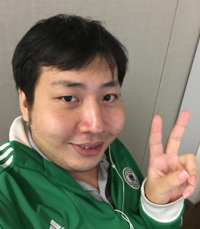
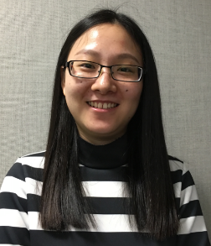
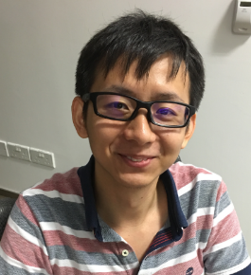
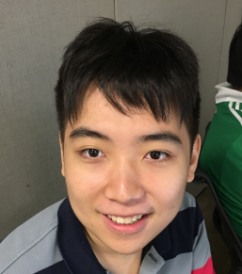

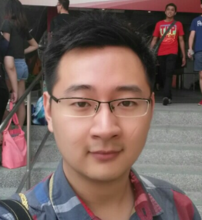
Amazing Team Members
CHEN
Weixi
Dev
Engineering
Solutions
LIU
Mingxia
Dev
Reality
Solutions
LIU
Siyuan
Dev
AutoCAD
TANG
Peter
Dev
Engineering
Solutions
XIE
Lekai
Dev
ISM
ZHANG
Jiao
QA
PLM

Slide 3

Teh 4 US
Collaboration starts with
“Hi, nice to know you!”
------
Know new people by
Getting others to help you
Kopi
…
Or
Helping others
JIRA API
JWT login
Firebase Backend
.
.
.
.

Slide 4
Live Demo

Slide 5
Q & A

Slide 6
Technical Design & Details

